Slide 1
The Human Voice

Slide 2
The human voice is the oldest and most versatile of any “musical instrument” – it is also the least understood!

Slide 3
The Vocal Tract…
Vocal tract comprises three main sections: Pharynx, mouth and nasal cavity
Sound produced through the interaction of many complex parts of the vocal tract and air being expelled from the lungs via the trachea
Lips, tongue, teeth, larynx (vocal cords) can produce an amazing variety of subtly different sounds

Slide 4
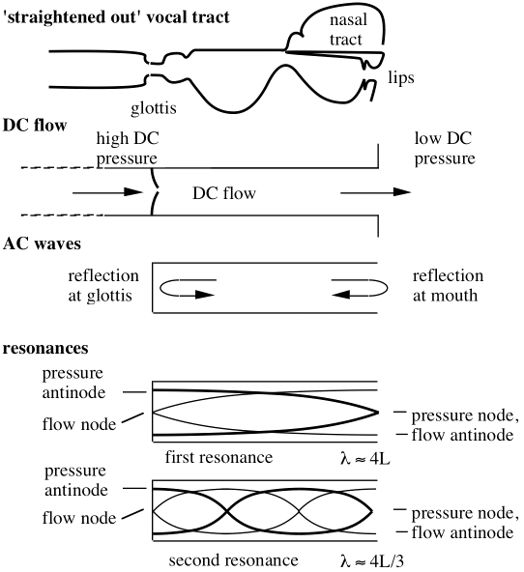
Trachea
Trachea (“wind pipe”) is typically about 17 cm in length in an adult and acts essentially like a pipe open at one end
What resonances would you expect to be produced by the trachea?
Tracheal resonances play a special role in shaping the spectra of sounds being created by the vocal tract – this leads to the idea of formants
Formants are peaks that occur in the sound spectra of vowels

Slide 5
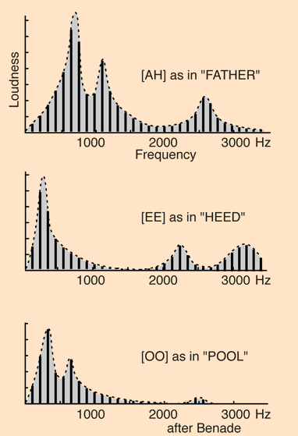
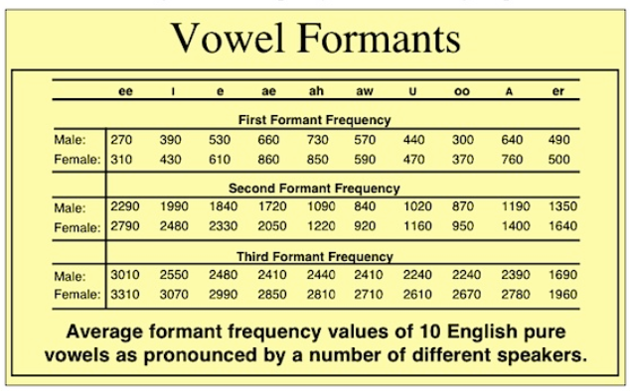

Slide 6
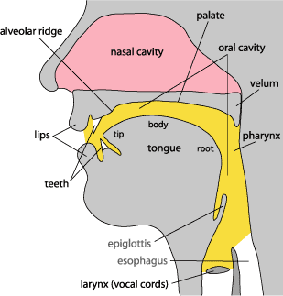
The Larynx
Vocal chords are the main contributor to the variety of sounds we can produce.
When modulated by the tracheal resonances formants are produced
Video of female singer’s larynx
Another discussion of how the voice works

